Slide 1


Status Report 2023​
Volume 3
Featuring projections for the
EV and E-Commerce markets
as well as data on Vehicle Population
aftermarketsuppliers.org

Slide 2



FOREWORD
Welcome to the 2023 AASA Automotive Aftermarket Status Report
The Automotive Aftermarket Suppliers Association (AASA), the light vehicle aftermarket division of the Motor & Equipment Manufacturers Association (MEMA), has published the Automotive Aftermarket Status Report since 1998. The AASA Status Report has become a key industry source for the vital statistics of the aftermarket – market size, average vehicle age, unperformed maintenance, miles driven, outlet channel comparison, DIY and DIFM markets, and more.
The AASA Status Report serves as a valuable industry resource and business planning tool for AASA’s full-service supplier members. The AASA Status Report is available free to members in a downloadable format from the association’s website (www.aftermarketsuppliers.org). Non-members may purchase electronic versions of the publication on the AASA website.
AASA’s goal in the Status Report is to provide a valuable business tool for its supplier member companies. This publication is just one part of the industry analysis and market insight AASA provides to its members, which ranges from data and data-driven insight to point-of-view and strategy. AASA strives to provide relevant and impactful aftermarket industry analysis to help its members be more profitable, innovative and competitive. A healthy supplier base is imperative for a growing and vibrant aftermarket.
To find out more about other publications and research from AASA’s Industry Analysis, visit www.aftermarketsuppliers.org/Research. Please contact the AASA Industry Analysis team with ideas and suggestions for improvement of AASA’s industry analysis programs and outputs at info@aftermarketsuppliers.org.
IMPORTANT CHANGES
AASA recently improved the format of the Status Report to make it more user-friendly. The changes were:
Converting from PDF to PowerPoint. This will make it easier for members to access the data behind the tables and graphs.
With the exception of Volume 3, we have enabled linking the Excel data to the graphs; to see the data that drives the graphs, readers click on the link in order to open the excel sheets. Links appear on every page that contains a graph.
Paul McCarthy
President & Chief Operating Officer
Philip Atkins
Director
Strategic Research & Planning
Sheel Chandra
Business Development Intern
Strategic Research & Planning
Zayd Shabandri
Member Support and
Analytics Intern
Strategic Research & Planning

Slide 3
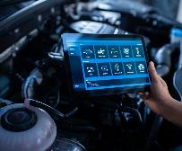
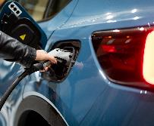

TABLE OF CONTENTS – Volume 3
2
12
FORWARD
CHAPTER 11
USED CAR SALES
3
14
CHAPTER 12
THE EV TREND
TABLE OF CONTENTS
5
CHAPTER 10
VEHICLE POPULATION
28
CHAPTER 13
GROWTH IN E-COMMERCE

Slide 4
Note:
IMPORTANT: Unlike Status Report Volumes 1and 2, there are no links to data underlying the charts and graphs in Volume 3.
Where the data are available, they are provided as a table accompanying the graph, on the slide.

Slide 5

5
Vehicle Population
CHAPTER 10

Slide 6
U.S.VEHICLES IN OPERATION
There were 283 million light cars and trucks on U.S. roads by 2022. Although the year-over-year change flattened out during the COVID-19 pandemic, the total number of vehicles is projected to increase in subsequent years.
Vehicles in Operation Millions
2017 | 2018 | 2019 | 2020 | 2021 | 2022 | 2023 | 2024 | 2025
272 | 278 | 281 | 279 | 280 | 283 | 286 | 291 | 295
S&P Global, Joint Channel Forecast; AASA and Auto Care

Slide 7
AVERAGE AGE BY VEHICLE TYPE
Yearly Vehicle Age by Car, Truck
Expressed in Years and Fractions of Years
1990-2008 data © 2009 Polk
2009-2021 data © 2022 Experian
AutoCount® data from Experian Automotive as of June 30, 2021

Slide 8




Make more informed decisions with demographic data based
on actual vehicle ownership – not just population generalities.
Buyer insight into lifestyle, behavioral and attitudinal characteristics
Available for U.S. cars and light trucks
Locate and maximize your untapped potential:
  Vocation data
  Parts in Operation
  Demographic data
We help the aftermarket connect the right parts, vehicles and customers.
Click to
LEARN MORE

Slide 9
VEHICLES ON THE ROAD BY AGE
Vehicles on the Road by Age Structure
 | 1-5 Years | 6-10 Years | Over 10 Years
2011 | 24.1% | 31.1% | 44.9%
2012 | 23.0% | 30.4% | 46.6%
2013 | 22.9% | 29.3% | 47.8%
2014 | 25.1% | 26.3% | 48.5%
2015 | 26.5% | 23.9% | 49.5%
2016 | 32.0% | 22.9% | 45.0%
2017 | 33.1% | 21.4% | 45.4%
2018 | 33.7% | 20.5% | 45.8%
2019 | 33.7% | 20.6% | 45.8%
2020 | 32.9% | 22.4% | 44.7%
2021 | 32.2% | 24.1% | 43.7%
AutoCount® data from Experian Automotive as of June 30, 2021

Slide 10
U.S. VEHICLE REGISTRATIONS BY AGE
Vehicle Age by Car, Truck
Age | Passenger Cars | Light Trucks | Total
1 | 6,218,562 | 17,933,128 | 24,151,690
2 | 4,801,087 | 12,079,470 | 16,880,557
3 | 5,334,423 | 11,210,794 | 16,545,217
4 | 6,303,363 | 10,898,046 | 17,201,409
5 | 6,436,294 | 9,836,707 | 16,273,001
6 | 7,031,517 | 9,439,209 | 16,470,726
7 | 6,711,883 | 7,942,959 | 14,654,842
8 | 7,017,914 | 6,970,072 | 13,987,986
9 | 6,180,815 | 6,129,706 | 12,310,521
10 | 4,783,485 | 6,012,324 | 10,795,809
11 | 4,749,846 | 4,674,338 | 9,424,184
12 | 4,196,571 | 3,476,139 | 7,672,710
13 | 5,066,402 | 6,010,256 | 11,076,658
14+ | 38,194,922 | 57,169,850 | 95,364,772
AutoCount® data from Experian Automotive as of June 30, 2021

Slide 11
U.S. VEHICLE REGISTRATIONS BY MODEL YEAR - 2021*
*U.S. Summary statistics as of Q2, 2021
AutoCount® data from Experian Automotive as of June 30, 2021

Slide 12

12
Used Car Sales
CHAPTER 11

Slide 13
MONTHLY USED CAR SALES – January 2021 to April 2022
Source: Cox Automotive Inc.

Slide 14
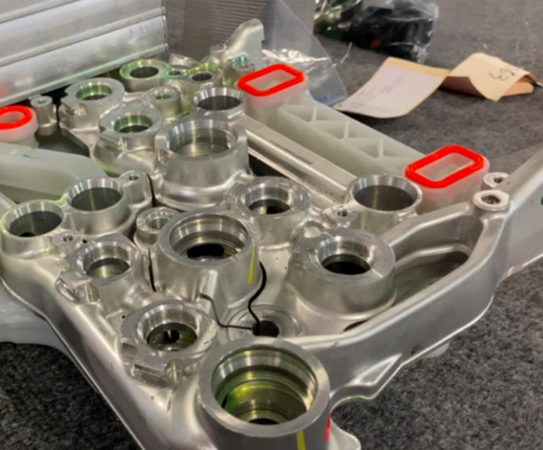
14
The EV Trend
CHAPTER 12

Slide 15
NOTE:
The slides in this section are drawn from the following sources:
The AASA Status Report, Volume 3. Free to members; $750 for non-members
Joint EV Forecast, Impact of New Technologies; PwC Strategy&. Free to members; $750 for non-members
  This report will be updated in Q4 2022 and presented at the AAPEX Show in November.
The U.S. Automotive Aftermarket in 2035; Roland Berger; Free to members; not available to non-members
Please refer to the AASA website, https://www.aftermarketsuppliers.org/resource, for information.
IMPORTANT: Unlike Status Report Volumes 1and 2, there are no links to data underlying the charts and graphs in Volume 3. Where the data are available, they are provided as a table accompanying the graph, on the slide.

Slide 16
TREND: ALTERNATE POWER TRAIN PARC
TOTAL PARC
Alternate Power Trains
2.39M
2.63M
2. 85M
3.04M
3.23M
3.37M
3.66M
 | Hybrid Car | Hybrid Truck | Electric Car | Electric Truck
2015 | 90% | 6% | 4%
2016 | 90% | 6% | 4%
2017 | 88% | 6% | 5% | 1%
2018 | 86% | 7% | 6% | 1%
2019 | 83% | 8% | 7% | 2%
2020 | 81% | 9% | 8% | 3%
2021 | 75% | 9% | 8% | 7%

Slide 17

ALTHOUGH CAR PARC GROWTH IS SLOWING, THE EV MIX BECOMES MORE EVIDENT BY 2030 AND GROWS RAPIDLY THROUGH 2045
2021-2045F U.S. percent of new car sales by propulsion type
[Percent of Total New Sales]
2021-2045F EV Parc Penetration in the U.S.
[Percent of Total Car Parc]
Base EV Adoption Percentage of Sales
Base EV Adoption Percentage of Parc
3%
9%
20%
43%
65%
79%
0.7%
2%
6%
13%
25%
36%
100%
100%
Low EV Adoption
2030 High EV Adoption = 11%
Low EV Adoption
Base EV Adoption
Non-EV
High EV Adoption
2045 High EV Adoption = 48%
Base EV Adoption
Non-EV
High EV Adoption
2021
2025
2030
2035
2040
2045
2021
2025
2030
2035
2040
2045
Base EV Adoption Scenario
Note(s):
1) “EV” includes BEV and PHEV propulsion types. “Non-EV” includes ICE and Hybrids (micro, mild, and full-hybrid)
Sources: IHS Markit. DOT. Strategy& research.
The 2021 Joint Electrification Forecast is copyright © 2021 PricewaterhouseCoopers Advisory Services LLC (PwC) and/or their licensors. All other rights reserved. Use of the Forecast is subject to compliance with the Legal Terms and Conditions found on page 30 of this report.

Slide 18

By 2035, only 5% of the
8+ year-old vehicles will be electric
US car parc by vehicle age, 2021-35 [m vehicles]
299
305
279
280
289
5%
7%
BEV
0%
1%
2%
32%
EVs
  0-3 years
21%
18%
15%
NON-BEV
22%
22%
2%
4%
BEV
0%
0%
0%
20%
EVs
17%
  4-7 years
21%
20%
NON-BEV
24%
24%
0%
2%
BEV
0%
11%
EVs
0%
0%
  8-11 years
18%
18%
NON-BEV
17%
19%
21%
0%
2%
BEV
0%
0%
0%
2%
EVs
  12+ years
NON-BEV
36%
35%
34%
37%
36%
2021
2022
2025
2030
2035
Notes:
Considering the most recent IHS forecast for electric vehicles in the US and extrapolating it until 2035 we can see that the penetration of EVs will still be very small in the older vehicle segments.
When we look at the IAM sweet-spot of 8+ year-old vehicles, we have only 5% of EVs, therefore, the impact of electrification for those suppliers focused on the IAM will still take decades to happen. With that said, the more a supplier is dependent on the OEM/OES, the faster the impact will come.

Slide 19
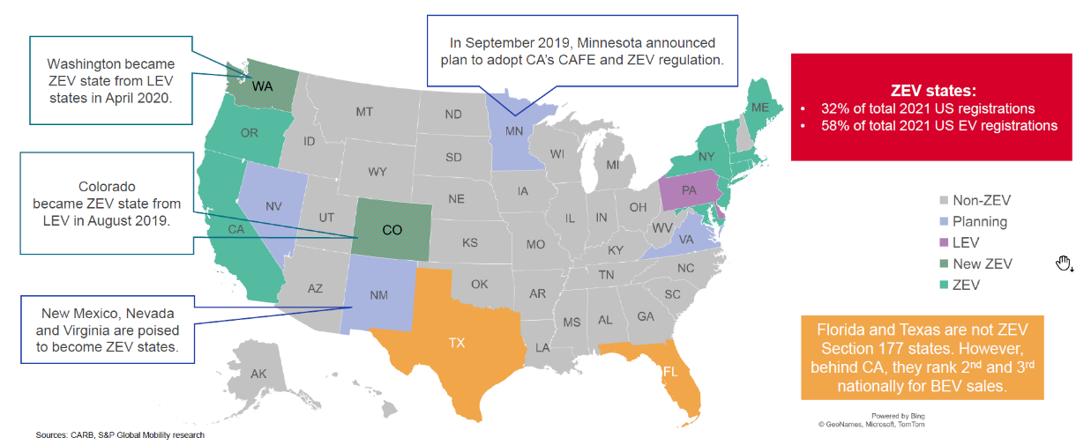

EVs SEEING WIDE REGIONAL VARIANCE
Source: S&P Global Mobility
Notes:
Another thing to keep in mind
Is that this will be a highly regional story
- CA makes up almost half of EV registrations
And 70% of EV sales have been in states that have adopted CA ZEV regulations
So location matters
Much more impact in LA, say,
than on pickups in the Dakotas
One reason Wall Street so enamored – EVs a perfect second luxury vehicle for the short ride to the train station in Greenwich CN to head Manhattan
Over-estimate the market
[old story on pickups]
As one customer told me recently – “Look at the coast and learn!”
And aftermarket companies
Who are well-versed in managing widely varying regional demand patterns
Are strategically planning accordingly

Slide 20

WITHIN THE FORECASTED MARKET, KEY GROWTH CONTRIBUTORS WILL BE ELECTRIFICATION & ADAS
2021-2045F Selected aftermarket parts size by product category¹
[USD, Billions]
2021-2045 CAGR
160
159
6.0%
14.9%
1.8%
0.9%
1.0%
1.1%
1.5%
1.0%
0.7%
0.4%
149
5
ADAS
140
5
21
Electrification
140
129
4
15
3
10
Category Market Size ($B)
120
117
2
5
19
20
Engine/ Transmission
108
1
2
17
18
15
9
9
9
Exhaust/ Emissions
100
13
1
8
7
8
25
25
Electrical and Electronics
80
23
24
20
21
7
7
Filters
6
7
7
12
Maintenance and Repair
60
6
9
10
11
12
9
16
17
Brakes
14
14
15
16
40
11
11
12
12
Chassis
10
11
20
15
15
16
16
16
16
HVAC
Other
0
0
2021
2025
2030
2035
2040
2045
Source: Joint AASA/Auto Care Electrification Study released at AAPEX 2021
Sources: IHS Markit. DOT. Strategy& research.
Notes: 1) “EV” includes BEV and PHEV propulsion types. “Non-EV” includes ICE and Hybrids (micro, mild, and full-hybrid)
Notes:
Looking a bit deeper at product categories
Good news:
We are the aftermarket
We have time to adjust
By 2030
Electrification will make up less than 4% of the replacement parts market
It is clear: we have a LONG tail for existing products
& categories
But EV Growth continues
By 2045
EV 13-14% of the aftermarket parts market

Slide 21
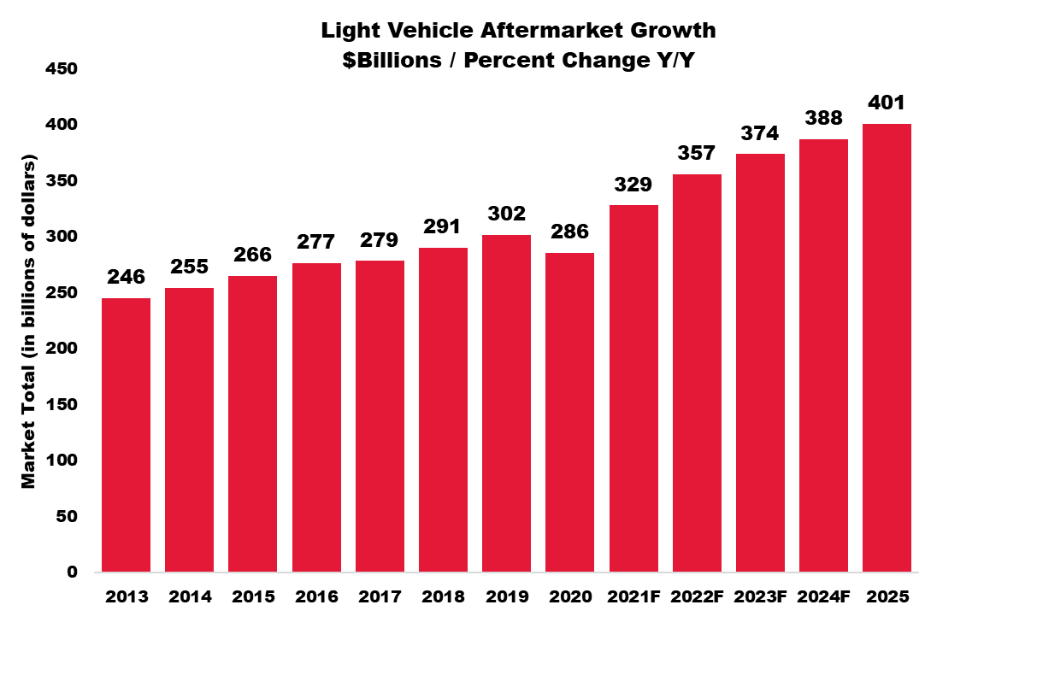
FIRST GENERATION OF EVS WILL JUST CONTINUE THE POSITIVE COMPLEXITY STORY FOR THE AFTERMARKET
Aftermarket Story of the Last 30-40 Years:
↑ Complexity
↑ Vehicle Content
↑ Cost Per Part
Replacement Rates Decline
Aftermarket Revenue Up
Increasing complexity & value/cost per part has increased faster than lower replacement rates
Notes:
The data indicates the story of the first couple of generations of EVs
Will be like the story of the last 3-4 decades of the aftermarket
Declining replacement rates
While nonetheless seeing increasing aftermarket revenue
As increasing complexity, vehicle content, and cost per component outpaces lower replacement rates
[By the way, not a bad thing in a world where we are looking at fewer, more highly trained, more expensive techs]

Slide 22
Are EV service costs really lower than ICE?
It depends…
[see next slides]

Slide 23
Methodology and Sourcing
The following slides are based on excerpts from a report on EV service prepared and written by We Predict, a company that was recently acquired by JD Power. All data in their report was sourced from dealer repair order systems reporting warranty claims and customer payments.
Service claims that were included in the data include:
Year 1 costs are based on model year 2020; Year 3 are based on MYs 2018, 2019, 2020. Data are based on U.S. service centers.
We Predict included a limited amount of hybrid data; some are included here, too.
Excluded claims include:
Unplanned repairs
Warranty
Service campaigns
Diagnostics
Maintenance
Software updates
Factory installed accessories
Recalls
Collision damage
Seasonal tire changes
Car washes

Slide 24
THOUGH EV SERVICE IS MORE EXPENSIVE THAN ICE AND HYBRID IN YEAR 1, BY YEAR 3 EVS’ COSTS ARE MUCH LOWER.
SOURCE: We Predict; DEEPVIEW TRUE COST; 2021

Slide 25
EV COSTS IN YEAR 1 ARE HIGHER ACROSS ALL THREE SERVICE COMPONENTS – PARTS, LABOR, AND RECALLS.
Service costs after 1 year of use
SOURCE: We Predict; DEEPVIEW TRUE COST; 2021

Slide 26
BY YEAR 3, EV SAVINGS ARE MOST EVIDENT IN MAINTENANCE WHERE EV OWNERS SPEND JUST 1/3 WHAT ICE OWNERS DO.
Service costs after 3 years of use
SOURCE: We Predict; DEEPVIEW TRUE COST; 2021

Slide 27
5 OF EV’S TOP 10 SERVICED PARTS ARE RELATED TO BATTERY AND CHARGING; 6 OF THE TOP FAILURE MODES ARE PROMINENT ON EV COMPONENTS
TOP 10 SERVICED PARTS
(All parts; in the first year)
Battery Charger/Cable
High Voltage Battery
Remote Keys/Transmitters
Battery Contact
Control Unit
Wiper Arm
HV Wiring
Battery Control Unit
Camera
IP/Display
TOP 10 FAILURE MODES
(All parts; in the first year)
Noise
Fault
Damaged
Leak
Broken
Failed
Dent
Seized
Overheat
Disconnected
SOURCE: We Predict; DEEPVIEW TRUE COST; 2021

Slide 28
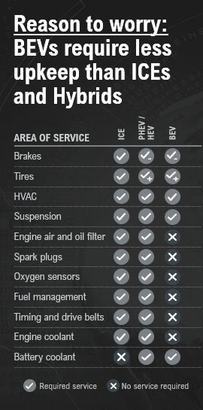
EVS: LESS SERVICE, MORE PROBLEMS?
    Parts/Replacement Rate Growth Opportunities
    Tires
    Suspension (more complex, more noticeable)
    Drivetrain (non-engine/transmission)
    Sensors, monitoring systems, electronics, etc.
    More Reman?
    Cooling systems, HVAC
    Problematic new technologies
    Battery refurbishment, inverters, etc.
    Infotainment + comfort/convenience + content
Source: AASA Aftermarket 2035 Study 4/22, Roland Berger, AASA analysis
Notes:
Listen – are reasons to worry
BEVs require less regularly scheduled maintenance
No spark plugs, drive belts, [oxygen sensors]
This matters
- Current filter and oil supply issues
- Lifeblood – bring it in for that; more things, this sound, etc.
[- It matters]
Don’t jump off the bridge yet
Other more problems
- Walk through left –
Tires
- (weight, instant torque; low rolling resistance, foam inside to deal with sound – tires a lot louder when don’t have an engine to cover up – last shorter, cost more
- Already investors placing bets on that growth
- Drivetrain – no engine or tranny, but wow – all that instant torque and weight might not be great for driveshafts and wheel bearings
- Suspension – an area where spending is growing in EVs
- W/o
- HVAC, cooling
- Very different technologies
- HVAC – heat pumps, a great example
- Some members already finding this
- Every time new technology – problems; failures
- Whether early gen fuel injection, electronic ignition, or TPMS
- Auto company engineers not perfect
- The real world is a difficult operating environment
- Every time we have a new generation of tech – found good for aftermarket – may be repeating

Slide 29
28
Growth in
E-Commerce
CHAPTER 12

Slide 30
NOTE:
The slides in this section are drawn from the 2021 Joint E-commerce Forecast, E-Commerce Momentum Shaping The Future Of The Aftermarket. This report is free to AASA members or $1500 for non-members. NOTE: This report will be updated in Q4 2022 and presented at the AAPEX Show in November 2022.
It was prepared by Jefferies. Also contributing are Hedges & Company and GCommerce via their work for the Joint AASA and Auto Care E-commerce Forecast 2021.
Please refer to the AASA website, https://www.aftermarketsuppliers.org/resource, for information.
IMPORTANT: Unlike Status Report Volumes 1and 2, there are no links to data underlying the charts and graphs in Volume 3. Where the data are available, they are provided as a table accompanying the graph, on the slide.

Slide 31
CONSUMER TRENDS DRIVING AFTERMARKET
E-COMMERCE GROWTH
COVID-19 accelerated the adoption of E-commerce with no other channel providing sufficient alternative shopping convenience and safety
2021 E-commerce sales of aftermarket parts & accessories (excluding marketplaces; see next page) is projected to exceed $18 billion
Retailers accelerated their plans to serve customers with digital solutions by upgrading E-commerce sites and adding new shopping options, such as curbside pick up, faster delivery, and BOPUS (Buy Online Pick Up in Store)
Across the board, industry participants have seen consumers become more and more sophisticated – driving awareness and comfort across the online channel
E-commerce Sales of Automotive Parts & Accessories (Excl. Marketplaces)
E-commerce Sales of New Automotive Parts & Accessories (Excluding Marketplaces)
($ in Millions)
5-Year CAGR: 9.1%
11.7%
Source(s): Hedges & Company
The 2021 Joint E-commerce Forecast is copyright © 2021 Auto Care Association, Automotive Aftermarket Suppliers Association (AASA) and/or its licensor. All other rights reserved. Use of the Forecast is subject to compliance with the Legal Terms and Conditions found on page 32 of this report.

Slide 32
MARKETPLACES EXPECTED TO DRIVE TOTAL 2021 ONLINE SALES TO $34.7 BILLION
Over the last decade, E-commerce sales of automotive parts and accessories grew at a robust CAGR of ~20%, from less than $4 billion in 2012 to more than $18 billion in 2021
In this timeframe, major E-commerce players Amazon, eBay, Walmart, and others have grown into multi-billion-dollar marketplace platforms offering millions of products from thousands of sellers
These 3rd party sellers must be accounted for when capturing total aftermarket online sales
The bridge presented below estimates that, inclusive of marketplaces, total online sales of new automotive parts and accessories in 2021 were $34.7 billion, representing $16.6 billion of incremental sales
Total 2021 Online Sales of Automotive Parts & Accessories
($ in Billions)
Remaining 70% of 3P sales are accounted for here, with an estimated total eBay Motors sales of ~$12B
Total 2021 Online Sales
55% of all units sold on Amazon were by 3P sellers
$34.7
$8.2
$2.1
30% of eBay Motors sales already accounted for within the $18.1B E-commerce sales
6.3
Estimated to be ~20% of Amazon’s total
$18.1
eBay Motors 3P
$3.5
Amazon 1P is accounted for within the $18.1B E-commerce sales
$5.2
Amazon 1P
Source(s): GCommerce Inc., Hedges & Company, Jefferies Automotive Aftermarket
The 2021 Joint E-commerce Forecast is copyright © 2021 Auto Care Association, Automotive Aftermarket Suppliers Association (AASA) and/or its licensor. All other rights reserved. Use of the Forecast is subject to compliance with the Legal Terms and Conditions found on page 32 of this report.

Slide 33
TOTAL ONLINE CHANNEL DRIVING SALES TO NEARLY $50 BILLION BY 2025
The consolidated view of aftermarket E-commerce has evolved to include large and growing third party sellers – representing key players in the online channel that will continue to expand over the projection period
Strong momentum in the channel is anticipated to drive total online sales to ~$50 billion by 2025 – representing an 8.6% growth CAGR from 2020 to 2025
As the online channel continues to grow and take share from traditional brick & mortar participants it will become increasingly important for legacy aftermarket players to adapt their market strategy and develop an E-commerce playbook
Online Sales of Automotive Parts & Accessories
($ in Billions)
Source(s): GCommerce Inc., Hedges & Company, Jefferies Automotive Aftermarket
5-Year CAGR: 8.6%
The 2021 Joint E-commerce Forecast is copyright © 2021 Auto Care Association, Automotive Aftermarket Suppliers Association (AASA) and/or its licensor. All other rights reserved. Use of the Forecast is subject to compliance with the Legal Terms and Conditions found on page 32 of this report.

Slide 34
THE ONLINE AFTERMARKET CONSUMER DEMOGRAPHIC
The online aftermarket purchaser skews younger with Millennial / Gen Z representing roughly 50% of this cohort
  Comparatively, in-store purchasers skew older, with less than 30% being Millennial / Gen Z and 68% representing Gen X / Boomers
Further, the online purchaser tends to be higher income relative to their in-store counterpart, with ~44% of online purchasers making $100K or more compared to only 27.1% of in-store shoppers
The younger, more affluent consumer is increasingly focused on the online channel, further exemplifying the channel’s importance and a brand’s corresponding online presence
Online Consumer Demographic Breakdown – Age & Income
Age
Household Income
~60%
$75,000+
~43%
$75,000+
~50%
Gen Z & Millennials
~27%
Gen Z & Millennials
Source(s): IMR Inc. | AutomotiveResearch.com
The 2021 Joint E-commerce Forecast is copyright © 2021 Auto Care Association, Automotive Aftermarket Suppliers Association (AASA) and/or its licensor. All other rights reserved. Use of the Forecast is subject to compliance with the Legal Terms and Conditions found on page 32 of this report.

Slide 35
USE OF THIS REPORT - LEGAL TERMS AND CONDITIONS
These terms govern the use of this report (the Report).
License Grant. This Report is provided by the Motor & Equipment Manufacturers Association (MEMA) and the Automotive Aftermarket Suppliers Association (AASA) (Association) to members for their use. We provide members (and only members) with a limited, revocable, non-exclusive, and nontransferable license to access and use the Report and its contents for any purpose they choose. Members may copy all or some of the Report; any copy or use of a portion must state: “Provided by the Automotive Aftermarket Suppliers Association (AASA).”
Proprietary Rights. The Report is owned by Association, Copyright © 2021 and the logos and marks of Association are proprietary to Association and any use without express written permission is prohibited. Accordingly, unauthorized use of the Report or any portion may violate intellectual property or other proprietary rights laws. You may not sell or license the Report or any portion.
WARRANTY DISCLAIMER AND LIMITATION OF LIABILITY. The Report is provided “as is’ and “as available.” Association disclaims all warranties, express or implied. Association is not liable for damages arising from use of the Report or any portion.

Slide 36



ACKNOWLEDGEMENTS
The 2023 AASA Automotive Status Report is sponsored by IMR Inc., one of the automotive industry’s most respected marketing research firms. IMR works with many successful OEM and aftermarket companies to help them gain knowledge of the industry and an understanding of their customers, channel partners and service and parts programs. AASA extends its thanks to IMR and its president, Bill Thompson.
Experian provided much of the data for this report and is well-known in the industry for expertise. AASA is grateful for this invaluable contribution. AASA is pleased to acknowledge the important contributions of Marty Miller and Jeff Zoellick of Experian Automotive.
AASA is also pleased to acknowledge the important contributions of Andrew King, Martin Stanczak, and Terry Chung with DesRosiers Automotive Consultants. Their valued input was instrumental in the production of this report.
DesRosiers Automotive Consultants Inc. 80 Fulton Way, Suite 101
Richmond Hill, ON L4B 1J5 Canada
Phone: 905-881-0400 www.desrosiers.ca
Experian Automotive
955 American Lane Schaumburg, IL 60173
Phone: 888-754-9977 www.experianautomotive.com
IMR Inc.
808 Quail Ridge Drive Westmont, IL 60559
Phone: 630-654-1079 www.automotivereserach.com

Slide 37

CONNECTING MEMBERS TO WHAT MATTERS
CONNECT WITH US!
Web: www.aftermarketsuppliers.org
Email: info@aftermarketsuppliers.org

