Slide 1


Status Report 2023
Volume 2
Quarter 3, 2022
aftermarketsuppliers.org

Slide 2



FOREWORD
Welcome to the 2023 AASA Automotive Aftermarket Status Report
The Automotive Aftermarket Suppliers Association (AASA), the light vehicle aftermarket division of the Motor & Equipment Manufacturers Association (MEMA), has published the Automotive Aftermarket Status Report since 1998. The AASA Status Report has become a key industry source for the vital statistics of the aftermarket – market size, average vehicle age, unperformed maintenance, miles driven, outlet channel comparison, DIY and DIFM markets, and more.
The AASA Status Report serves as a valuable industry resource and business planning tool for AASA’s full-service supplier members. The AASA Status Report is available free to members in a downloadable format from the association’s website (www.aftermarketsuppliers.org). Non-members may purchase electronic versions of the publication on the AASA website.
AASA’s goal in the Status Report is to provide a valuable business tool for its supplier member companies. This publication is just one part of the industry analysis and market insight AASA provides to its members, which ranges from data and data-driven insight to point-of-view and strategy. AASA strives to provide relevant and impactful aftermarket industry analysis to help its members be more profitable, innovative and competitive. A healthy supplier base is imperative for a growing and vibrant aftermarket.
To find out more about other publications and research from AASA’s Industry Analysis, visit www.aftermarketsuppliers.org/Research. Please contact the AASA Industry Analysis team with ideas and suggestions for improvement of AASA’s industry analysis programs and outputs at info@aftermarketsuppliers.org.
IMPORTANT CHANGES
AASA recently improved the format of the Status Report to make it more user-friendly. The changes were:
Converting from PDF to PowerPoint. This will make it easier for members to access the data behind the tables and graphs.
Embedding the Excel data within the graphs; to see the data that drives the graphs, readers merely click on the provided link in order to open the excel sheets. Links appear on every page that contains a graph.
Paul McCarthy
President & Chief Operating Officer
Philip Atkins
Director
Strategic Research & Planning
Sheel Chandra
Business Development Intern
Strategic Research & Planning
Zayd Shabandri
Member Support and
Analytics Intern
Strategic Research & Planning

Slide 3
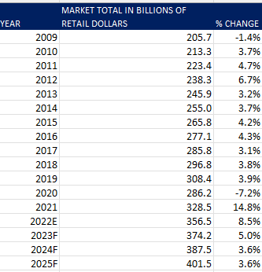
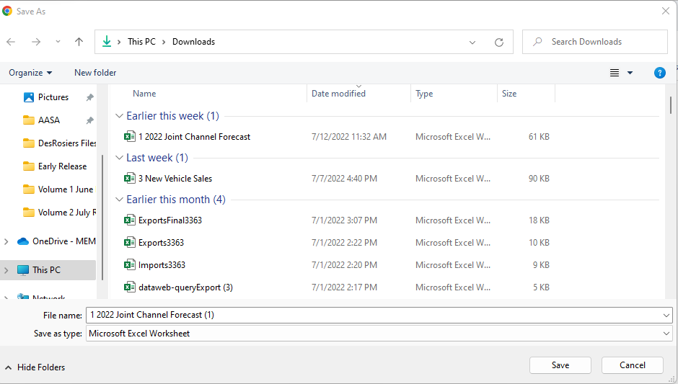
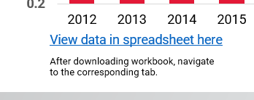
Directions for Download
To download the data workbooks, hold control + click on the links below the graphs and tables in this report
The link will open an option to download the workbook
After downloading the workbook, open it and navigate to the necessary tab for the expanded dataset
Hold Control + Click on these links
Accept the file download and open the workbook
View the expanded dataset in the downloaded workbook

Slide 4
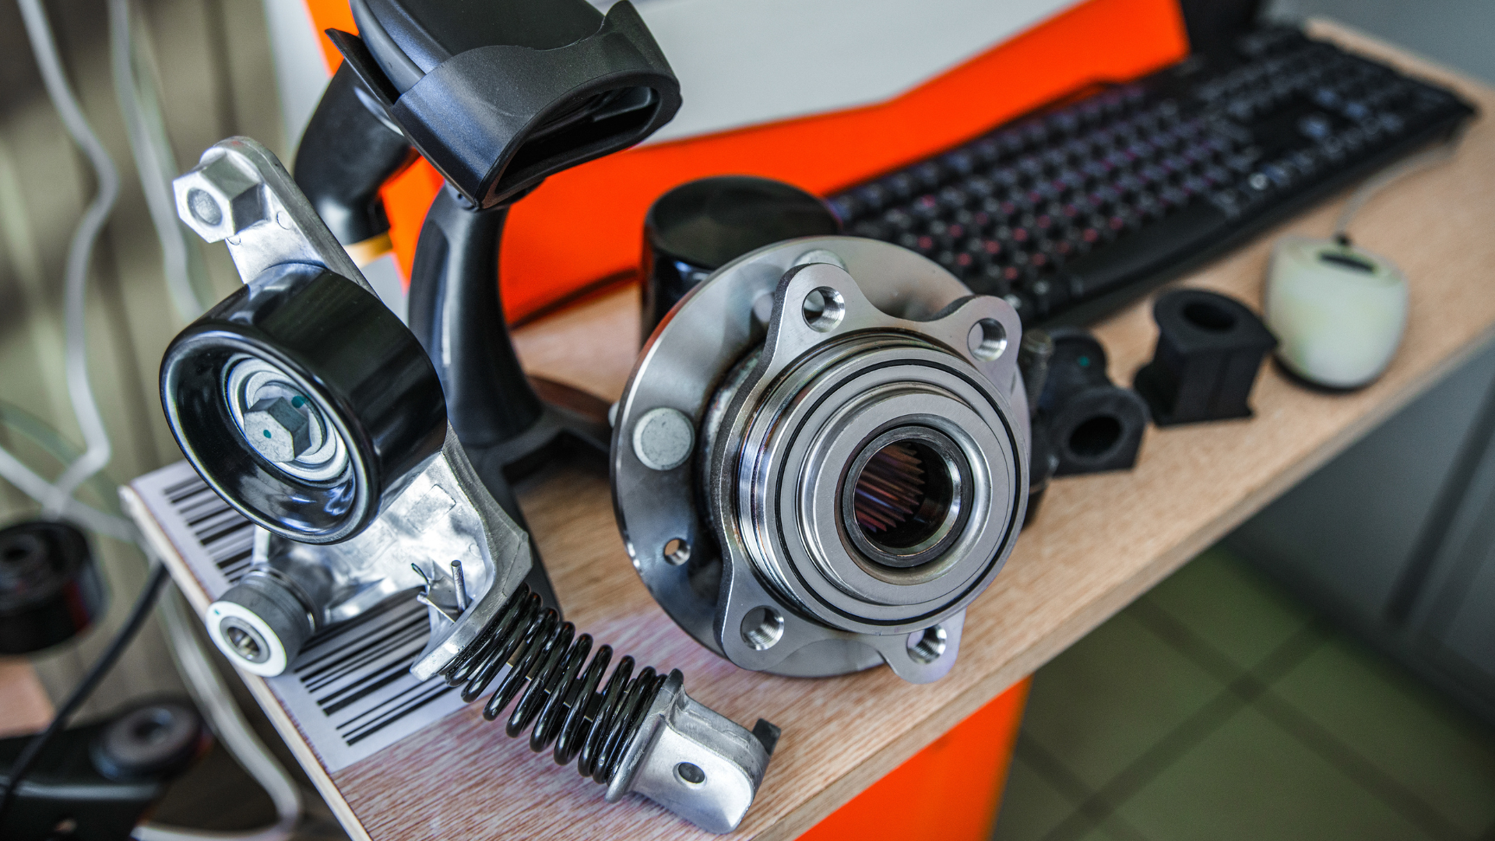


TABLE OF CONTENTS
2
25
FORWARD
CHAPTER 7
UNPERFORMED MAINTENANCE
4
TABLE OF CONTENTS
32
CHAPTER 8
DO-IT-YOURSELF MARKET
5
CHAPTER 5
SIZE OF THE AFTERMARKET (ALTERNATIVE VIEW)
39
CHAPTER 9
INTERNATIONAL MARKETS: CANADA
11
CHAPTER 6
AFTERMARKET SUBSECTORS
54
APPENDIX

Slide 5
05
SIZE OF THE AFTERMARKET (ALTERNATIVE VIEW)
CHAPTER 5

Slide 6
SIZE OF THE AFTERMARKET
Note on Methodology
The 2023 AASA Status Report contains two different ways to size the aftermarket.
The first, the Joint Channel Forecast Model, is in the first volume of this report. This market sizing is jointly conducted with the Auto Care Association, and the analysis is completed by S&P Global, formerly IHS Markit.
The second set of aftermarket sizing techniques is contained in this chapter, specifically the following two slides. This market sizing is conducted by DesRosiers Automotive Consultants and uses as its starting point IMR consumer survey data, plus additional analysis.
See full explanation in Appendix 1.

Slide 7
U.S. LIGHT VEHICLE AFTERMARKET SIZE AND OUTLOOK
Click here for Data
After downloading workbook, navigate to the corresponding tab.
Source: DesRosiers Automotive Consultants Inc.

Slide 8
SHARE OF AFTERMARKET PARTS AND SERVICES SPEND
Click here for Data
Source: Federal Highway Administration
After downloading workbook, navigate to the corresponding tab.

Slide 9
U.S. EXPORTS OF AUTOMOTIVE PARTS
IN MILLIONS
COUNTRY | 2018 | 2019 | 2020 | 2021 | 2020-2021 % CHANGE
WORLD | 48,589.02 | 46,158.78 | 36,471.30 | 38,320.47 | 5.07%
MEXICO | 16,347.38 | 16,520.89 | 12,870.05 | 14,516.62 | 12.79%
CANADA | 17,985.37 | 17,152.53 | 12,649.04 | 11,967.45 | -5.39%
CHINA | 2,662.76 | 1,609.31 | 2,003.82 | 1,851.40 | -7.61%
JAPAN | 985.46 | 752.18 | 536.73 | 755.42 | 40.74%
BRAZIL | 763.67 | 699.08 | 549.02 | 749.67 | 36.55%
GERMANY | 1,063.49 | 945.15 | 711.09 | 748.48 | 5.26%
UNITED KINGDOM | 1,332.36 | 1,258.83 | 723.74 | 674.47 | -6.81%
AUSTRALIA | 624.93 | 582.16 | 526.39 | 599.8 | 13.95%
SPAIN | 384.5 | 508.08 | 629.86 | 526.64 | -16.39%
Source: United States International Trade Commission
Click here for Data
After downloading workbook, navigate to the corresponding tab.

Slide 10
U.S. IMPORTS OF AUTOMOTIVE PARTS
IN MILLIONS
COUNTRY | 2018 | 2019 | 2020 | 2021 | 2020-2021 % CHANGE
WORLD | 121,114.94 | 118,355.43 | 102,493.18 | 117,528.23 | 14.67%
MEXICO | 49,233.57 | 50,122.84 | 43,688.89 | 49,278.05 | 12.79%
CANADA | 14,032.13 | 13,603.04 | 11,476.53 | 13,171.88 | 14.77%
CHINA | 15,320.47 | 12,539.43 | 10,301.23 | 12,387.66 | 20.25%
JAPAN | 12,231.14 | 11,204.28 | 9,250.65 | 10,984.82 | 18.75%
REPUBLIC OF KOREA | 5,950.08 | 6,540.84 | 5,756.45 | 7,405.99 | 28.66%
GERMANY | 7,308.94 | 6,686.82 | 6,239.74 | 5,293.90 | -15.16%
TAIWAN | 2,578.41 | 2,695.02 | 2,611.63 | 3,085.74 | 18.15%
INDIA | 1,445.47 | 1,529.23 | 1,139.91 | 1,875.53 | 64.53%
ITALY | 857.12 | 1,049.3 | 1,037.12 | 1,580.32 | 52.38%
Source: United States International Trade Commission
Click here for Data
After downloading workbook, navigate to the corresponding tab.

Slide 11
06
AFTERMARKET SUBSECTORS
CHAPTER SIX

Slide 12
AFTERMARKET SUBSECTORS
Note on Methodology
Accompanying the previous chapter that talked about the whole market is this chapter reporting about subsectors. Keep in mind, while the survey that is used as foundational data for much of the analysis here – a broad consumer survey from IMR – is extremely well-respected in the aftermarket industry, it has limitations when applied to the detailed segment-level estimates attempted in this chapter.
For example, since it is based on consumer data, there can be the usual issues with consumer data, including recall, completeness of data provided, and a lack of understanding technical questions and repairs. In some cases, AASA members have indicated these factors led to the data depicted in this chapter under-counting (and in some cases over-counting) in some product segments. Other segments, perhaps those better understood by end consumers, appear to be very accurate, according to feedback.
We continue to provide the data in this chapter to members because it is helpful to many members and can provide a useful baseline or source of data triangulation to others.

Slide 13




Make more informed decisions with demographic data based
on actual vehicle ownership – not just population generalities.
Buyer insight into lifestyle, behavioral and attitudinal characteristics
Available for U.S. cars and light trucks
Locate and maximize your untapped potential:
  Vocation data
  Parts in Operation
  Demographic data
We help the aftermarket connect the right parts, vehicles and customers.
Click to
LEARN MORE

Slide 14

TOTAL REGULAR MAINTENANCE BY VEHICLE AGE: 2021
VEHICLE AGE | TOTAL PURCHASE INCIDENCE | TOTAL PURCHASE ITEMS/JOBS | TOTAL MARKET SIZE
NEW | 60.3 | 117,403 | $6,511,235
1 YEAR OLD | 224.4 | 25,246,613 | $1,126,533,907
2 YEARS OLD | 172.5 | 31,023,330 | $1,639,507,518
3 YEARS OLD | 252.1 | 56,562,493 | $3,359,320,068
4 YEARS OLD | 311.7 | 69,860,905 | $4,314,994,465
5 YEARS OLD | 350.0 | 83,369,777 | $5,240,543,340
6 YEARS OLD | 376.0 | 84,206,792 | $5,125,586,419
7 YEARS OLD | 357.8 | 80,574,314 | $4,875,738,425
8 YEARS OLD | 372.4 | 74,405,183 | $4,397,226,667
9 YEARS OLD | 361.9 | 69,695,798 | $4,158,545,131
10 YEARS OLD | 382.4 | 64,401,727 | $3,812,107,475
11 YEARS OLD | 346.1 | 51,014,322 | $2,983,766,338
12 YEARS OLD | 372.3 | 48,307,095 | $2,899,885,517
13 YEARS OLD | 376.2 | 39,339,012 | $2,321,432,107
14 YEARS OLD | 367.5 | 55,764,249 | $3,328,394,978
15+ YEARS OLD | 278.3 | 301,789,316 | $12,876,424,381
TOTAL |  | 1,135,678,327 | $62,466,517,969
Click here for Data
Sources: DesRosiers Automotive Consultants Inc. and AutoCount@ data from Experian Automotive
After downloading workbook, navigate to the corresponding tab.

Slide 15
ESTIMATED REGULAR MAINTENANCE MARKET SIZE: 2021
Using Maintenance Intervals
CATEGORY | INTERVAL (MILES) | PRICE ($) | # OF ITEMS REPLACED | MARKET SIZE ($)
TUNE-UPS | 30,000 | 124 | 1.00 | $10,665,332,171
HEADLAMPS | 100,000 | 15 | 1.46 | $550,531,065
AIR FILTERS | 25,000 | 18 | 1.08 | $2,036,210,787
OIL CHANGES | 6,000 | 28 | 1.00 | $11,802,872,008
BATTERIES | 40,000 | 116 | 1.04 | $7,747,513,488
TIRES | 45,000 | 141 | 4.00 | $32,214,193,298
WIPER BLADES REPLACED | 25,000 | 12 | 1.72 | $2,165,411,684
TRANSMISSION FLUID CHANGED | 60,000 | 115 | 1.09 | $5,360,416,824
TOTAL |  |  |  | $72,542,481,325
Click here for Data
Sources: DesRosiers Automotive Consultants Inc. and AutoCount@ data from Experian Automotive
After downloading workbook, navigate to the corresponding tab.

Slide 16
ESTIMATED REGULAR MAINTENANCE MARKET SIZE: 2021
Using Purchase Incidence
CATEGORY | PURCHASE INCIDENCE | UNITS PURCHASED | MARKET SIZE ($)
TUNE-UPS | 0.7 | 2,138,480.1 | $265,716,833
HEADLAMPS | 11.8 | 49,621,503.2 | $726,636,322
AIR FILTERS | 48.3 | 145,464,442.6 | $2,662,649,778
OIL CHANGES | 138.8 | 392,380,788.6 | $10,791,079,612
BATTERIES | 31.1 | 90,799,361.8 | $10,507,272,655
TIRES | 37.2 | 240,358,399.1 | $34,019,641,698
WIPER BLADES REPLACED | 42.5 | 206,449,085.9 | $2,523,383,243
TRANSMISSION FLUID CHANGED | 2.6 | 8,466,266.1 | $970,137,828
TOTAL |  |  | $62,466,517,969
Click here for Data
Sources: DesRosiers Automotive Consultants Inc. and AutoCount@ data from Experian Automotive
After downloading workbook, navigate to the corresponding tab.

Slide 17
TOTAL ENGINE WORK BY VEHICLE AGE: 2021
VEHICLE AGE (YEARS OLD) | TOTAL PURCHASE INCIDENCE | TOTAL PURCHASE ITEMS/JOBS | TOTAL MARKET SIZE
NEW | 0.08 | 18,043 | $4,149,960
1 | 0.23 | 2,460,911 | $510,169,707
2 | 0.17 | 2,620,241 | $575,139,447
3 | 0.21 | 4,041,475 | $779,601,250
4 | 0.19 | 3,321,204 | $697,490,847
5 | 0.18 | 3,320,553 | $677,175,821
6 | 0.20 | 3,418,858 | $811,476,899
7 | 0.17 | 3,065,446 | $758,172,731
8 | 0.16 | 2,537,134 | $585,447,177
9 | 0.17 | 2,522,612 | $679,379,704
10 | 0.18 | 2,405,888 | $616,424,970
11 | 0.20 | 2,475,514 | $642,198,293
12 | 0.21 | 2,177,155 | $501,729,580
13 | 0.22 | 1,789,814 | $483,932,628
14 | 0.24 | 2,860,372 | $777,020,217
15+ | 0.28 | 28,313,562 | $6,792,175,391
TOTAL |  | 67,348,782 | $15,891,684,621
Click here for Data
Sources: DesRosiers Automotive Consultants Inc. and AutoCount@ data from Experian Automotive
After downloading workbook, navigate to the corresponding tab.

Slide 18
ESTIMATED DRIVETRAIN WORK MARKET SIZE: 2021
Using Maintenance Intervals
CATEGORY | INTERVAL (MILES) | PRICE ($) | # OF ITEMS REPLACE | MARKET SIZE ($)
ALTERNATORS | 200,000 | 247 | 1.00 | $3,181,151,588
ENGINE OVERHAUL | 250,000 | 1830 | 0.10 | $1,885,380,358
FUEL PUMPS | 200,000 | 403 | 1.00 | $5,184,795,984
FUEL FILTERS | 90,000 | 55 | 1.00 | $1,571,150,298
IGNITION WIRE SETS | 120,000 | 64 | 0.10 | $137,475,651
STARTERS | 200,000 | 258 | 1.00 | $3,322,088,684
DISTRIBUTOR CAPS | 40,000 | 27 | 0.10 | $176,754,409
TRANSMISSION OIL FILTERS | 160,000 | 122 | 1.00 | $1,963,052,404
CV JOINTS | 160,000 | 275 | 1.31 | $5,788,706,880
TRANSMISSION REPLACEMENT | 200,000 | 1439 | 0.30 | $5,557,199,394
TOTAL |  |  |  | $28,767,755,651
Click here for Data
Sources: DesRosiers Automotive Consultants Inc. and AutoCount@ data from Experian Automotive
After downloading workbook, navigate to the corresponding tab.

Slide 19
ESTIMATED DRIVETRAIN WORK MARKET SIZE: 2021
Using Purchase Incidence
CATEGORY | PURCHASE INCIDENCE | UNITS PURCHASED | MARKET SIZE ($)
ALTERNATORS | 0.04 | 10,874,145.2 | $2,686,752,748
ENGINE OVERHAUL | 0.01 | 21,384.8 | $39,143,749
FUEL PUMPS | 0.02 | 5,679,805.8 | $2,287,248,602
FUEL FILTERS | 0.05 | 15,102,818.4 | $829,347,336
IGNITION WIRE SETS | 0.01 | 2,309,531.1 | $147,961,615
STARTERS | 0.02 | 4,875,983.5 | $1,258,118,806
DISTRIBUTOR CAPS | 0.02 | 7,612,838.6 | $209,023,484
TRANSMISSION OIL FILTERS | 0.03 | 8,466,266.1 | $1,032,671,048
CV JOINTS | 0.02 | 8,974,277.6 | $2,464,041,170
TRANSMISSION REPLACEMENT | 0.01 | 3,431,731.3 | $4,937,376,063
TOTAL |  |  | $15,891,684,621
Click here for Data
Sources: DesRosiers Automotive Consultants Inc. and AutoCount@ data from Experian Automotive
After downloading workbook, navigate to the corresponding tab.

Slide 20
TOTAL UNDERCAR WORK BY VEHICLE AGE: 2021
VEHICLE AGE | TOTAL PURCHASE INCIDENCE | TOTAL PURCHASE ITEMS/JOBS | TOTAL MARKET SIZE
NEW | 0.23 | 46,500 | $11,666,030
1 YEAR OLD | 0.44 | 4,896,364 | $917,661,432
2 YEARS OLD | 0.36 | 6,100,358 | $1,205,754,450
3 YEARS OLD | 0.48 | 10,573,946 | $1,993,865,910
4 YEARS OLD | 0.53 | 12,541,456 | $2,112,183,348
5 YEARS OLD | 0.62 | 17,389,691 | $2,539,271,769
6 YEARS OLD | 0.68 | 17,935,009 | $2,621,213,961
7 YEARS OLD | 0.66 | 17,384,334 | $2,662,406,128
8 YEARS OLD | 0.69 | 17,675,804 | $2,377,628,646
9 YEARS OLD | 0.73 | 17,506,810 | $2,432,253,951
10 YEARS OLD | 0.78 | 16,493,437 | $2,243,868,514
11 YEARS OLD | 0.81 | 13,925,490 | $2,162,899,794
12 YEARS OLD | 0.75 | 11,763,356 | $1,670,425,815
13 YEARS OLD | 0.82 | 10,798,435 | $1,469,286,551
14 YEARS OLD | 0.78 | 14,912,303 | $2,025,157,338
15+ YEARS OLD | 0.75 | 112,503,584 | $17,805,334,040
TOTAL |  | 302,446,878 | $46,250,877,675
Click here for Data
Sources: DesRosiers Automotive Consultants Inc. and AutoCount@ data from Experian Automotive
After downloading workbook, navigate to the corresponding tab.

Slide 21
ESTIMATED UNDERCAR MARKET SHARE: 2021
Using Maintenance Intervals
CATEGORY | INTERVAL (MILES) | PRICE ($) | # OF ITEMS REPLACE | MARKET SIZE ($)
LININGS | 30,000 | 92 | 1.00 | $7,855,751,491
ROTORS (PAIRS) | 40,000 | 140 | 1.00 | $9,041,266,008
CALIPERS (PAIRS) | 100,000 | 128 | 1.00 | $3,299,415,626
SHOCKS (OR STRUTS, PAIRS) | 180,000 | 329 | 1.00 | $4,713,450,895
EXHAUST PIPES | 160,000 | 149 | 1.00 | $2,390,897,159
MUFFLERS | 160,000 | 110 | 1.10 | $1,944,298,494
CATALYTIC CONVERTERS* | 160,000 | 340 | 1.00 | $5,472,999,403
RACK & PINION | 180,000 | 384 | 1.00 | $5,499,026,044
WHEEL BEARING | 160,000 | 227 | 1.00 | $3,649,264,085
ALIGNMENT | 60,000 | 92 | 1.00 | $3,927,875,746
CLUTCH REPLACED* | 120,000 | 688 | 0.10 | $1,475,344,080
TOTAL |  |  |  | $49,269,589,031
Click here for Data
* Some vehicles do not have these parts and therefore will not get this item fixed or replaced
Sources: DesRosiers Automotive Consultants Inc. and AutoCount@ data from Experian Automotive
After downloading workbook, navigate to the corresponding tab.

Slide 22
ESTIMATED UNDERCAR MARKET SHARE: 2021
Using Purchase Incidence
CATEGORY | PURCHASE INCIDENCE | UNITS PURCHASED | MARKET SIZE ($)
LININGS | 0.14 | 95,978,218.2 | $8,784,152,915
ROTORS (PAIRS) | 0.10 | 69,119,135.7 | $9,707,463,143
CALIPERS (PAIRS) | 0.04 | 23,663,106.0 | $3,031,984,585
SHOCKS (OR STRUTS, PAIRS) | 0.08 | 22,822,330.9 | $7,519,512,788
EXHAUST PIPES | 0.04 | 12,280,981.3 | $1,824,450,823
MUFFLERS | 0.04 | 12,591,898.4 | $1,382,928,290
CATALYTIC CONVERTERS* | 0.06 | 16,278,691.0 | $5,535,834,229
RACK & PINION | 0.01 | 1,916,871.2 | $736,833,596
WHEEL BEARING | 0.02 | 5,143,489.0 | $1,166,275,909
ALIGNMENT | 0.13 | 38,192,804.6 | $3,495,495,566
CLUTCH REPLACED* | 0.02 | 4,459,351.4 | $3,065,945,831
TOTAL |  |  | $46,250,877,675
Click here for Data
* Some vehicles do not have these parts and therefore will not get this item fixed or replaced
Sources: DesRosiers Automotive Consultants Inc. and AutoCount@ data from Experian Automotive
After downloading workbook, navigate to the corresponding tab.

Slide 23
TOTAL COOLING SYSTEM AND A/C WORK BY VEHICLE AGE: 2021
VEHICLE AGE | TOTAL PURCHASE INCIDENCE | TOTALPURCHASE ITEMS/JOBS | TOTAL MARKET SIZE
NEW | 0.16 | 23,278 | $9,325,613
1 YEAR OLD | 0.30 | 2,479,191 | $874,144,394
2 YEARS OLD | 0.24 | 3,216,471 | $1,031,066,988
3 YEARS OLD | 0.25 | 3,759,655 | $1,398,835,017
4 YEARS OLD | 0.25 | 3,715,146 | $1,333,701,530
5 YEARS OLD | 0.21 | 3,357,973 | $1,162,788,570
6 YEARS OLD | 0.26 | 3,748,160 | $1,378,444,286
7 YEARS OLD | 0.23 | 3,327,268 | $1,308,338,808
8 YEARS OLD | 0.19 | 2,538,468 | $898,884,919
9 YEARS OLD | 0.21 | 2,621,628 | $961,464,695
10 YEARS OLD | 0.24 | 2,743,129 | $856,881,156
11 YEARS OLD | 0.30 | 3,017,979 | $1,168,619,947
12 YEARS OLD | 0.32 | 2,741,608 | $956,964,379
13 YEARS OLD | 0.30 | 2,122,717 | $652,540,953
14 YEARS OLD | 0.31 | 3,171,491 | $976,257,357
15+ YEARS OLD | 0.36 | 32,708,877 | $10,940,533,162
TOTAL |  |  | $25,908,791,773
Click here for Data
Sources: DesRosiers Automotive Consultants Inc. and AutoCount@ data from Experian Automotive
After downloading workbook, navigate to the corresponding tab.

Slide 24
ESTIMATED COOLING SYSTEM AND A/C MARKET SHARE: 2021
Using Maintenance Intervals
CATEGORY | INTERVAL (MILES) | PRICE ($) | # OF ITEMS REPLACE | MARKET SIZE ($)
A/C HEATER BLOWERS* | 140,000 | 275 | 0.3 | $1,515,037,788
A/C COMPRESSORS* | 200,000 | 602 | 0.4 | $3,098,559,662
A/C CONDENSERS* | 160,000 | 471 | 0.4 | $3,031,199,670
RADIATORS REPLACED | 280,000 | 589 | 1.0 | $5,412,856,553
THERMOSTATS | 200,000 | 73 | 1.0 | $942,690,179
WATER PUMPS | 320,000 | 432 | 1.0 | $3,473,249,621
COOLING SYSTEM FLUSHES | 100,000 | 118 | 1.0 | $3,031,199,670
RADIATOR HOSES REPLACED | 160,000 | 110 | 1.1 | $1,944,298,494
TOTAL |  |  |  | $22,449,091,636
Click here for Data
* About half the vehicles will not get this item fixed or replaced if it fails
Sources: DesRosiers Automotive Consultants Inc. and AutoCount@ data from Experian Automotive
After downloading workbook, navigate to the corresponding tab.

Slide 25
ESTIMATED COOLING SYSTEM AND A/C MARKET SHARE: 2021
Using Purchase Incidence
CATEGORY | PURCHASE INCIDENCE | UNITS PURCHASED | MARKET SIZE ($)
A/C HEATER BLOWERS* | 0.02 | 4,619,496.7 | $1,268,361,688
A/C COMPRESSORS* | 0.08 | 21,350,165.8 | $12,845,450,275
A/C CONDENSERS* | 0.02 | 6,876,722.2 | $3,237,980,516
RADIATORS REPLACED | 0.02 | 5,710,810.5 | $3,361,247,643
THERMOSTATS | 0.07 | 21,790,765.6 | $1,595,473,815
WATER PUMPS | 0.02 | 6,084,872.9 | $2,626,368,726
COOLING SYSTEM FLUSHES | 0.04 | 104,072.6 | $12,250,931
RADIATOR HOSES REPLACED | 0.02 | 8,756,131.6 | $961,658,179
TOTAL |  |  | $25,908,791,773
Click here for Data
* About half the vehicles will not get this item fixed or replaced even if it fails
Sources: DesRosiers Automotive Consultants Inc. and AutoCount@ data from Experian Automotive
After downloading workbook, navigate to the corresponding tab.

Slide 26
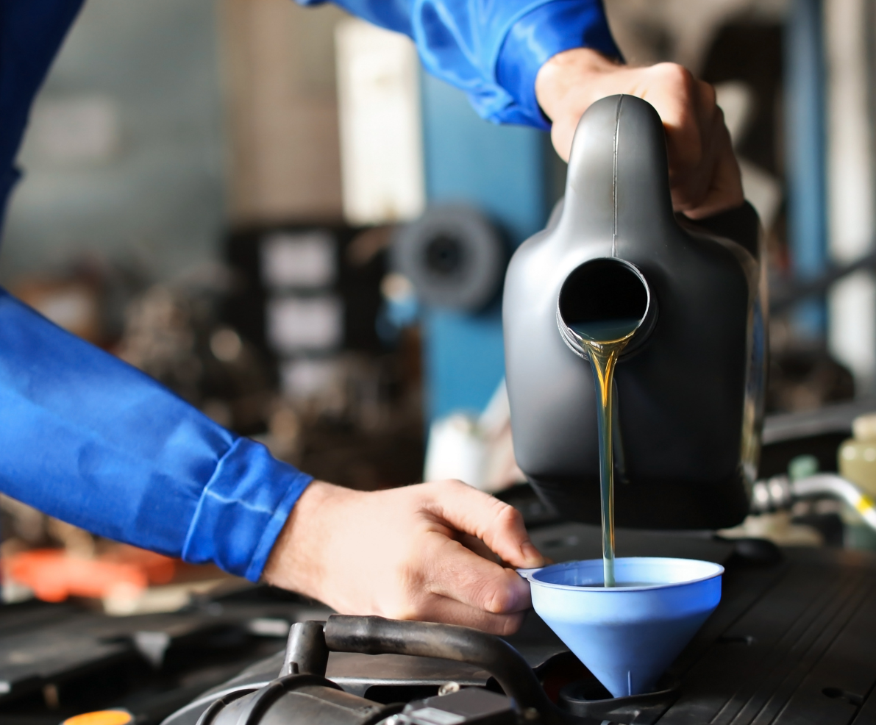
07
UNPERFORMED MAINTENANCE
CHAPTER 7

Slide 27
UNPEFORMED MAINTENANCE
Note on Methodology
Unperformed and underperformed maintenance represent a significant portion of the potential market for automotive market products, the part that AASA has long dubbed the “Missing Market” or the “Untapped Market.”
In 2021, unperformed and underperformed maintenance in the U.S. was $33.1 billion, an increase of $4.8 billion from 2020. Please note that unperformed maintenance is in end-consumer dollars and includes parts and labor.
The “Untapped Market” represents 13.5 percent of the total aftermarket potential, representing about a fifth of the industry’s potential market. In other words, while the portion of the automotive aftermarket covered in this analysis* totaled an estimated $245 billion in 2021, if consumers had performed the necessary maintenance to keep their vehicles safe, reliable and running efficiently, the aftermarket would have totaled $278 billion.
*The total market size mentioned here differs from the size described in Chapter 1 – Joint Channel Forecast, because it is based upon the method used by DesRosier as described in Appendix 1.

Slide 28
UNPERFORMED MAINTENANCE
Click here for Data
Source: DesRosiers Automotive Consultants Inc. and AutoCount@ data from Experian Automotive
After downloading workbook, navigate to the corresponding tab.

Slide 29
TOTAL UNPERFORMED MAINTENANCE
 | 2020 UNPERFORMED MAINTENANCE | 2021 UNPERFORMED MAINTENANCE
REGULAR MAINTENANCE | $2,968,692,801 | $10,075,963,355
ENGINE – POWERTRAIN | $9,949,154,781 | $12,876,071,029
UNDERCAR WORK | $9,817,323,061 | $3,018,711,356
COOLING SYSTEM – AC | $5,623,995,726 | $7,146,754,958
TOTAL | $28,359,166,369 | $33,117,500,700
Source: DesRosiers Automotive Consultants Inc. and AutoCount@ data from Experian Automotive
Click here for Data
After downloading workbook, navigate to the corresponding tab.

Slide 30
TOTAL AFTERMARKET POTENTIAL PARTS SALES
Methodology
AASA and MEMA have reported the estimate of vehicle maintenance that annually goes unperformed or underperformed since 1978.
The methodology used since 1998 to estimate unperformed maintenance is based on analysis of a broad basket of product groups, specifically regular maintenance, engine, undercar and cooling and A/C.
There have been two methodology changes over time:
From 1978 to 1998, unperformed maintenance was based on a market basket of 33 parts, a narrower set than now used.
In 2003, the methodology was updated so that it removed the negative impact to the estimate that occurs when maintenance for certain items is performed at a rate higher than normal or recommended maintenance intervals (as, for example, in the tire segment).
Click here for Data
Source: DesRosiers Automotive Consultants Inc. AutoCount@ data from Experian Automotive
After downloading workbook, navigate to the corresponding tab.

Slide 31
TOTAL AFTERMARKET POTENTIAL PARTS SALES
Source: DesRosiers Automotive Consultants Inc. and AutoCount@ data from Experian Automotive
Click here for Data
After downloading workbook, navigate to the corresponding tab.

Slide 32
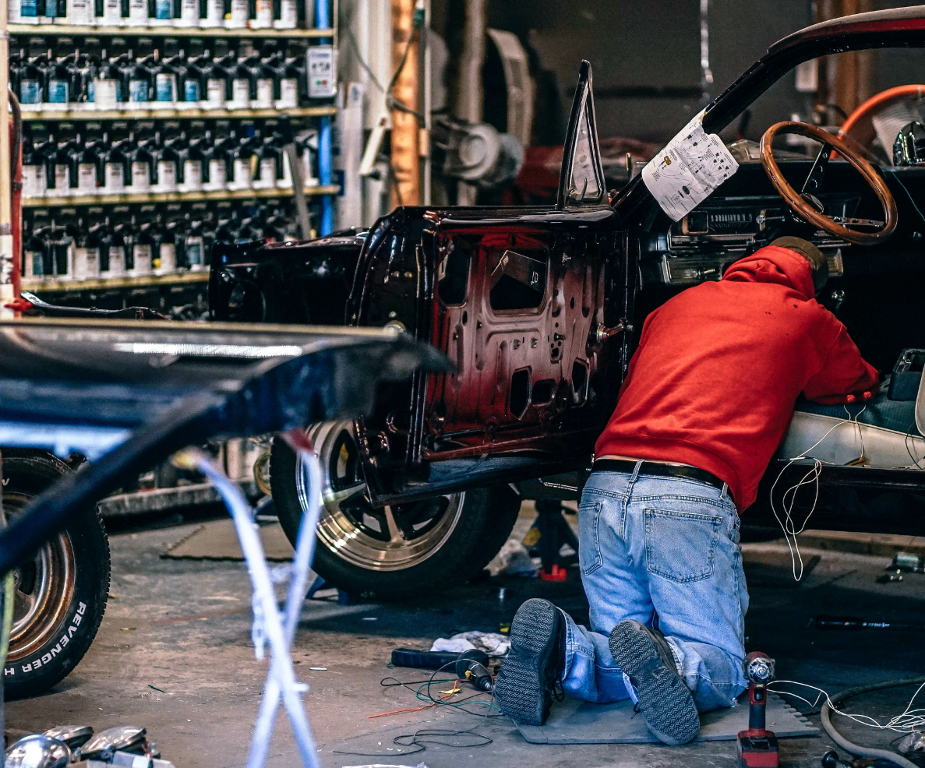
08
DO-IT-YOURSELF MARKET
CHAPTER 8

Slide 33
DO-IT-YOURSELF MARKET
The following pages detail where the changes in DIY occurred across age of vehicle, income, and other descriptive attributes.
A REMINDER: The DIY market is often misunderstood and frequently overestimated.
One reason for the overestimation is the large volume of motor vehicle parts that are purchased by professional installers at outlets that are considered retail establishments. These over-the-counter (OTC) sales obscure the true size of the DIY market. This is unique to the automotive aftermarket. Analogies of professional OTC sales in other industries would be physicians shopping for medical supplies at the local drug store, or restaurant managers buying produce at the supermarket; it might happen, but it is not common practice.
In addition, the trend toward ever more complex and technically sophisticated vehicles has led to a long-term shift in favor of the do-it-for-me (DIFM) market.

Slide 34
DO-IT-YOURSELF MARKET
The DIY market is comprised of people of all ages and backgrounds who perform some of their own vehicle maintenance. Consumers do their own automotive maintenance for a variety of reasons including cost and performance. That said, many DIYers are not capable of, nor have the equipment for, many of the service tasks that a modern motor vehicle requires. Although some may be able to perform major system overhauls, most are limited to simple tasks such as windshield wiper replacement or checking and topping off fluid levels.
To aid in analysis, AASA sub-divides the DIY market in three categories depending on the complexity of the maintenance and repair task:
• Difficult DIY
• Moderate DIY
• Easy DIY
These three categories were defined based on the results of a dedicated AASA survey and market study. For each of the difficulty categories, the study identified a “basket” of representative service tasks which have been tracked over time. Details on which maintenance jobs are assigned to which “basket” are shown at the end of this chapter.
Analysis of these baskets of difficult, moderate, and easy DIY tasks reveals trends in DIY versus DIFM activity and allow continuity of analysis over time. Note that the baskets were not designed to be all-inclusive indicators of the scope, value, or number of DIY jobs performed.

Slide 35
SHARE OF DIY ACTIVITY BY REPAIR DIFFICULTY: 2021 vs. 2020 vs. 2019
Click here for Data
After downloading workbook, navigate to the corresponding tab.
Graph by DesRosiers Automotive Consultants Inc.

Slide 36
DIY BY INCOME: 2021
DIY repair is most often performed by those in households with lower-than-average income. The elimination of labor charges provides significant savings, and this is important for the most cost-conscious consumers. When targeting their marketing efforts to these DIYers, manufacturers should be aware that this cost consciousness extends to the price of the parts selected by consumers in this largest segment of the DIY population. While professional installers can pass on costs of expedited or premium parts to the vehicle owner, there is no such option for the DIY customer. While a professional service operation cannot afford a part failure or problem that would tie up the technician and the service bay, the cost-benefit calculation may be different for a DIY consumer.
Click here for Data
After downloading workbook, navigate to the corresponding tab.
Graph by DesRosiers Automotive Consultants Inc.

Slide 37
DIY BY VEHICLE AGE: 2021
Most aftermarket activity increases as vehicles age and parts wear out or fail, and DIY activity follows a
similar pattern.
As vehicles age, the cost of a repair represents a greater proportion of the value of a car. Therefore, lowering the
cost of a car repair by doing the repair yourself has a greater economic value. In addition, older vehicles tend to be lower cost and, hence, are more accessible to consumers in lower income brackets. Those in the lower income brackets also have the greatest participation in DIY. Thus, vehicle age and household income are linked and reinforce one another in leading to higher levels of DIY as vehicles age.
Click here for Data
After downloading workbook, navigate to the corresponding tab.
Graph by DesRosiers Automotive Consultants Inc.

Slide 38
DIY BY VEHICLE TYPE: 2021
The level of DIY participation on pickup trucks is much higher than other vehicle types for every service category. In turn, the average rates for DIY activity on vehicles that are primarily used for passenger transportation (e.g. cars, SUVs, vans) remain relatively similar for all three levels of DIY complexity. This might be due to the pervasive use of pickups by people in professions such as construction, plumbing, electrical work, and other businesses; consumers who are accustomed to working with tools and are more comfortable performing vehicle repairs.
In addition, for these businesses, performing maintenance without interruption to their normal business activities is important.
Click here for Data
After downloading workbook, navigate to the corresponding tab.
Graph by DesRosiers Automotive Consultants Inc.

Slide 39

09
INTERNATIONAL
MARKETS: CANADA
CHAPTER 9

Slide 40
CANADIAN GROSS DOMESTIC PRODUCT
(in billions of Canadian dollars, constant 2012 prices)
Click here for Data
After downloading workbook, navigate to the corresponding tab.

Slide 41
EXCHANGE RATE
Click here for Data
After downloading workbook, navigate to the corresponding tab.

Slide 42
U.S. AUTOMOTIVE TRADE WITH CANADA
(U.S. Dollars in Millions)
 | 2019 | 2020 | 2021 | % CHANGE | AVERAGE ANNUAL % CHANGE 2016-2021
VEHICLE EXPORTS | 29,810 | 22,837 | 27,224 | -23.4% | 0.7%
VEHICLE IMPORTS | 41,457 | 30,349 | 26,102 | -26.8% | -9.1%
VEHICLE BALANCE | -11,647 | -7,512 | 1,122 | -35.5% | 38.2%
PARTS EXPORTS | 19,577 | 14,369 | 13,676 | -26.6% | -7.0%
PARTS IMPORTS | 13,600 | 11,394 | 13,205 | -16.2% | -0.7%
PARTS BALANCE | 5,976 | 2,975 | 470 | -50.2% | -36.7%
TOTAL EXPORTS | 49,387 | 37,206 | 40,899 | -24.7% | -2.3%
TOTAL IMPORTS | 55,057 | 41,743 | 39,307 | -24.2% | -6.8%
TOTAL BALANCE | -5,671 | -4,537 | 1,592 | -20.0% | 29.4%
Source: U.S. Census Bureau and U.S. International Trade Administration
Click here for Data
After downloading workbook, navigate to the corresponding tab.

Slide 43
CANADIAN NEW LIGHT MOTOR VEHICLE SALES
Click here for Data
After downloading workbook, navigate to the corresponding tab.

Slide 44
CANADIAN CAR AND TRUCK PRODUCTION
NUMBER OF UNITS
(includes Medium/Heavy Duty Trucks)
YEAR | PASSENGER CAR | TRUCK | TOTAL | PERCENT CHANGE | PERCENT PASSENGER CAR
2017 | 639,823 | 1,398,975 | 2,038,798 | 4.6% | 31.4%
2018 | 577,711 | 1,407,281 | 1,984,992 | -2.6% | 29.1%
2019 | 484,687 | 1,429,670 | 1,914,357 | -3.6% | 25.3%
2020 | 308,593 | 1,228,795 | 1,537,388 | -19.7% | 20.1%
2021 | 308,169 | 1,330,229 | 1,638,398 | 6.6% | 18.8%
2021/2020 | -0.1% | 8.3% | 6.6%
Source: DesRosiers Automotive Consultants Inc. and Ward's Automotive Reports
Click here for Data
After downloading workbook, navigate to the corresponding tab.

Slide 45
SEGMENTATION OF LIGHT VEHICLE SALES IN CANADA: 2021
Segmentation of Light Vehicle Sales in Canada: 2021
Canadian New Passenger Car Sales by Brand: 2021
Canadian New Light Truck Sales by Brand: 2021
Source: DesRosiers Automotive Consultants Inc., GAC and CVMA
Click here for Data
After downloading workbook, navigate to the corresponding tab.

Slide 46
CANADIAN PRODUCTION-TO-SALES RATIO
CALENDAR YEAR | CANADA TOTAL | N. AMERICAN TOTAL
2017 | 105% | 80%
2018 | 101% | 79%
2019 | 100% | 77%
2020 | 93% | 74%
2021 | 68% | 70%
Click here for Data
After downloading workbook, navigate to the corresponding tab.

Slide 47
CANADA MOTOR VEHICLE GASOLINE ENGINE AND ENGINE PARTS MANUFACTURING SHIPMENTS
in Thousands of Canadian Dollars
 | 2017 | 2018 | 2019 | 2020 | 2021
JANUARY | 473,837 | 463,624 | 500,631 | 513,927 | 380,534
FEBRUARY | 445,095 | 493,372 | 502,881 | 558,110 | 353,020
MARCH | 540,906 | 514,648 | 547,684 | 344,065 | 475,523
APRIL | 445,520 | 485,701 | 464,839 | 18,601 | 289,058
MAY | 505,893 | 485,738 | 526,154 | 120,399 | 288,542
JUNE | 482,821 | 488,081 | 509,784 | 433,333 | 364,702
JULY | 288,167 | 378,481 | 404,838 | 425,033 | 289,987
AUGUST | 489,911 | 562,042 | 555,815 | 472,510 | 300,581
SEPTEMBER | 427,512 | 509,561 | 404,005 | 550,734 | 247,368
OCTOBER | 488,459 | 536,773 | 349,766 | 402,778 | 361,587
NOVEMBER | 537,821 | 509,537 | 510,384 | 355,017 | 362,030
DECEMBER | 407,273 | 382,188 | 391,721 | 308,608 | 313,495
TOTAL ($1000’S) | 5,533,215 | 5,809,746 | 5,668,502 | 4,503,115 | 4,026,427
Click here for Data
Note: Statistics Canada published revised estimates going back to 2009 as of May 2018
After downloading workbook, navigate to the corresponding tab.

Slide 48
CANADIAN LIGHT VEHICLE REGISTRATIONS
 | PASSENGER CARS | LIGHT TRUCKS | TOTAL
2016 | 12,855,742 | 13,407,410 | 26,263,152
2017 | 12,486,421 | 14,285,381 | 26,771,802
2018 | 12,602,539 | 14,653,551 | 27,256,090
2019 | 12,230,282 | 15,143,260 | 27,373,542
2020 | 11,438,564 | 15,589,595 | 27,028,159
Click here for Data
After downloading workbook, navigate to the corresponding tab.

Slide 49
LIGHT VEHICLES ON THE ROAD IN CANADA
Source: IHS Automotive, driven by POLK, DesRosiers Automotive Consultants Inc. Further reproduction prohibited without written authorization of DesRosiers Automotive Consultants Inc.
Click here for Data
After downloading workbook, navigate to the corresponding tab.

Slide 50
OVERVIEW OF THE MECHANIC INSTALLED MARKET
 | DURING 2019 | DURING 2020 | DURING 2021
CANADIAN TIRE | 9.8% | 14.4% | 10.5%
DEPARTMENT STORES | 1.5% | 1.1% | 1.9%
INDEPENDENT REPAIR SHOPS | 35.7% | 27.6% | 36.8%
NEW CAR DEALERS | 35.4% | 25.8% | 33.9%
SERVICE STATIONS | 0.9% | 1.2% | 0.8%
SPECIALTY SHOPS | 6.3% | 13.3% | 5.8%
TIRE STORES | 1.2% | 2.4% | 1.2%
ALL OTHER OUTLETS | 9.2% | 14.2% | 9.1%
TOTAL MI REPAIRS | 100.0% | 100.0% | 100.0%
Excludes Paint, Body Work, Equipment, Heavy Duty Truck, Bus, Motorcycle
Source: Driven by POLK, 2018 light vehicle registration database released 2018 and DesRosiers Automotive Consultants Inc.
Further reproduction prohibited without written authorization from DesRosiers Automotive Consultants Inc.
Click here for Data
After downloading workbook, navigate to the corresponding tab.

Slide 51
OVERVIEW OF THE MECHANIC INSTALLED MARKET PERCENT OF SERVICE JOBS IN 2021
Click here for Data
After downloading workbook, navigate to the corresponding tab.

Slide 52
OVERVIEW OF THE DIY MARKET
 | DURING 2019 | DURING 2020 | DURING 2021
AUTO PARTS STORES | 33.9% | 13.3% | 29.2%
CANADIAN TIRE | 41.2% | 52.0% | 40.5%
WALMART | 2.5% | 7.5% | 2.0%
NEW CAR DEALERS | 4.5% | 3.2% | 4.6%
SERVICE STATIONS | 2.0% | 1.5% | 1.8%
INTERNET STORES | - | 1.1% | -
ALL OTHER OUTLETS | 15.9% | 21.4% | 21.9%
TOTAL DIY REPAIRS | 100.0% | 100.0% | 100.0%
Source: DesRosiers Automotive Consultants Light Vehicle Study 2005-2017
*Based on number of jobs, not dollars spent
Click here for Data
After downloading workbook, navigate to the corresponding tab.

Slide 53
OVERVIEW OF THE DIY MARKET SHARE IN 2021
Click here for Data
After downloading workbook, navigate to the corresponding tab.

Slide 54
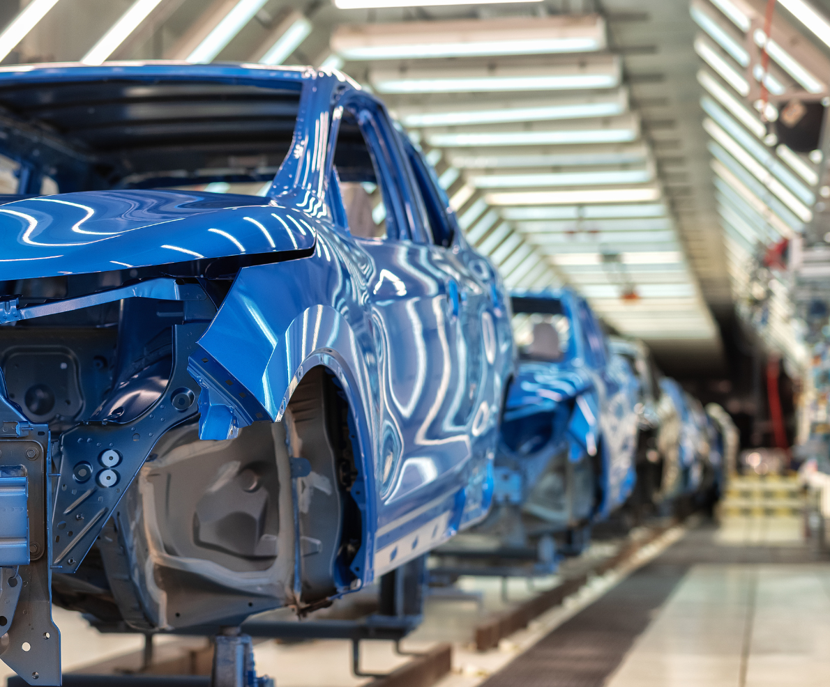
APPENDIX

Slide 55
Comparison of this Aftermarket Sizing to the Joint Channel Forecast Model
The 2023 AASA Status Report contains two different ways to size the aftermarket, as it did prior to 2011.
The first, the Joint Channel Forecast Model, is in the first chapter of this report. This market sizing is jointly conducted with the Auto Care Association, and the analysis is completed by IHS Markit. The second set of aftermarket sizing techniques is contained in this Appendix. This market sizing is conducted by DesRosiers Automotive Consultants and uses as its starting point IMR consumer survey data, plus additional analysis.
AASA presents both market sizing methods for several reasons:
They use very different techniques: top-down for the Joint Channel forecast and bottom-up for the analysis presented in this chapter. Different estimate techniques can come up alternative answers. AASA prefers to provide its members with all available useful data; furthermore, triangulation of data through different data techniques also can be useful.
The “bottom-up” methodology employed in this chapter can contribute to market sizing estimates of individual product and market segments, which the top-down Joint Channel forecast does not allow. Please see the “Notes on Methodology” in this chapter and the following appendix chapter, “Market Size: Key Aftermarket Subsectors” for more information.
Finally, many AASA members have long utilized the market sizing technique contained in this chapter. AASA continues to make it available to users of the Status Report.

Slide 56
Comparison of this Aftermarket Sizing to the Joint Channel Forecast Model
There are several differences in the two methodologies:
First, they are not directly comparable. The market-sizing methodology in this Appendix excludes certain segments, as detailed in the “OEM and Aftermarket Parts Markets Defined” section. The joint channel forecast attempts to cover all of the aftermarket apart from warranty repairs.
Second, there is a significant difference in the bottom-up versus top-down methodology, as noted above. To clarify, the methodology used here is the “Survey Cost Method”, detailed below in the “Note on Methodology” section. Fundamentally, it is based on data from annual consumer surveys. In contrast, the Joint Channel Forecast Model assigns slices of U.S. GDP to the aftermarket, utilizing Census Data on sales by channel outlets. In other words, it estimates what percentage of total U.S. end sales can be attributed to the aftermarket. Current market data also is a forecast, as the Census only reports detailed splits every five years. In other years, the market size is estimated, or forecast, based on IHS’s econometric model, based on actual results of economic drivers plugged into a model of how those drivers tend to impact aftermarket demand.
In the end, there is no direct way to measure the size of the light vehicle automotive aftermarket. Despite these data limitations, the AASA Status Report provides a variety of well-respected estimate techniques to allow the industry to gain better insight into the size of and outlook for the total aftermarket.

Slide 57
Note on Findings
Given data limitations, it is not easy to state the size of the automotive light vehicle aftermarket. Despite these challenges, AASA and its data partners have long employed a variety of well-respected estimation techniques to gain a better size of and outlook for the total aftermarket.
Using the Survey Cost Method (explained below), the value of the U.S. Light Vehicle Automotive Aftermarket in 2016 is again estimated at $192.8 billion. (See “OEM and Aftermarket Parts Defined” below for details on what segments are included and excluded from this estimate). This represented a 0.7 percent decrease from 2015’s figure of $194.0 billion (Note: last year’s Status Report estimated that 2015 would be $192.8 billion; we now estimate that it came in at $194. 0 billion)
As the U.S. economy continues to recover, moderate growth in aftermarket revenues is expected in the coming years, with modest expansion projected for 2017 and 2018. Fewer vehicles on the road aged 6-10 years is one of the contributing factors to the modest growth in the U.S. aftermarket. Not only are vehicles lasting longer but new car sales are forecasted to rise in the upcoming years.

Slide 58
Note on Methodology: Market Sizing Methods
Three different market sizing methods are used in different parts of this study. Each method is used where it is most appropriate and applicable to the specific analysis being conducted. The methodology and the value and limitations of each method are discussed below.
Survey Cost Method
This method involves multiplying the number of vehicles on the road for each model year by a survey-derived estimate of service and repair dollars spent on vehicles by model year. This method is helpful in estimating the overall market size of the aftermarket, as it accurately captures the full spectrum of aftermarket activity. However, it offers limited means of further breaking down the data. For example, it does not allow analyzing or estimating expenditures by type of product/service or DIY / DIFM share.
Survey Incidence Method
This method involves multiplying the incidence of vehicle maintenance reported through survey data by the number of vehicles on the road. This is a useful approach since it builds upon the actual incidence of vehicle repair. This method is particularly valuable for estimating the market size or share of particular products and services or specific channels. This method is limited in that it is difficult to estimate the entire size of the aftermarket due to the numerous types of products and services available, and there is some margin of error driven by sampling and the accuracy of maintainer responses.
Maintenance Interval Method
This method involves dividing total miles driven by manufacturers’ recommended maintenance/replacement intervals and multiplying by expenditures per job as derived by survey data. This method rests on the assumption that vehicle owners follow manufacturers’ maintenance schedules. Therefore, this method is valuable in estimating the potential market size of an aftermarket category, as it can estimate what the size of the aftermarket should be if consumers were properly maintaining their vehicle.
However, some vehicle owners (especially owners of older vehicles) will often delay certain types of repair and maintenance, as long as the vehicle remains in basic running order. Frequency of repair also varies based on demographics. For example, muffler repair is more common in areas that use road salt in the winter. Finally, this method is not useful in determining estimates for low-incidence items that may not fail during the life of many vehicles.

Slide 59
OEM & Aftermarket Parts Markets Defined
Original Equipment Manufacturer Parts
The Original Equipment Manufacturer (OEM) parts market includes components used in the manufacturing of new vehicles, including passenger cars, light trucks, heavy duty trucks and specialty vehicles. Information for this market is easily obtainable since there are a relatively small number of vehicle assemblers. Government agencies, industry associations and trade journals gather information on new vehicle unit production and estimate the resulting parts dollar volume.
The Aftermarket
Defining the aftermarket is a more difficult process, and involves a heterogeneous range of products traveling through a complex and varied distribution system. In simple terms, the automotive aftermarket is defined as the part of the automotive industry concerned with the manufacturing, re-manufacturing, distribution, retailing and installation of all vehicle parts, chemicals, tools, equipment and accessories, except those products that are used in the assembly of new vehicles.
The estimates presented in this publication are those of parts and services for light vehicles only. Vehicle types specifically excluded from the aftermarket estimates presented in this publication include:
Medium and heavy-duty trucks and trailers
Off-highway equipment
Farm machinery
Motorcycles and scooters
Snowmobiles
Watercraft of all types
Industrial equipment
Recreational vehicles
In terms of aftermarket components and services, the scope of the data presented in this section is restricted to replacement parts and related services. Specifically excluded from the study are the following categories:

Slide 60
OEM & Aftermarket Parts Markets Defined
Appearance Products and Related Services
This category includes items such as: accessories, car washes, vehicle detailing, vehicle customizing, rust proofing and car care products produced by specialized manufacturers or distributed through specialty channels.
Gasoline Sales
Gasoline sales, while technically part of the U.S. aftermarket, are excluded. Other petroleum products used in vehicle maintenance, such as engine oil, are included.
Dealer Preparation
A certain amount of parts and labor must go into each new vehicle before it can be sold. This can include such items as dewaxing and other types of preparation and cleaning of vehicles. It also includes the installation of dealer-installed options. All of these items fall within the realm of the broad definition of the aftermarket but are not included in the estimates presented.

Slide 61
OEM & Aftermarket Parts Markets Defined
Port of Entry Preparation and Accessorization
A wide range of aftermarket type work occurs to import vehicles before they even reach the dealership. Many products and services on these vehicles are installed at the vehicles’ port of entry. Examples of these jobs include the installation of roof racks, running boards, rear step bumpers, striping and air conditioning.
Car Audio and Entertainment Centers
Car audio and entertainment is a significant but distinct segment of the aftermarket; however, it is not included in the market estimates provided.
Hand Tools and Service Diagnostic Equipment
Tools and equipment are purchased by service and repair outlets and by DIY installers. Though they are vital to the automotive aftermarket, estimated figures do not include these expenditures.
Paint, Body and Equipment
In this category, only regular maintenance and repair work carried out by body shops as a result of collisions is included. Collision-related work is not included.

Slide 62
USE OF THIS REPORT - LEGAL TERMS AND CONDITIONS
These terms govern the use of this report (the Report).
License Grant. This Report is provided by the Motor & Equipment Manufacturers Association (MEMA) and the Automotive Aftermarket Suppliers Association (AASA) (Association) to members for their use. We provide members (and only members) with a limited, revocable, non-exclusive, and nontransferable license to access and use the Report and its contents for any purpose they choose. Members may copy all or some of the Report; any copy or use of a portion must state: “Provided by the Automotive Aftermarket Suppliers Association (AASA).”
Proprietary Rights. The Report is owned by Association, Copyright © 2021 and the logos and marks of Association are proprietary to Association and any use without express written permission is prohibited. Accordingly, unauthorized use of the Report or any portion may violate intellectual property or other proprietary rights laws. You may not sell or license the Report or any portion.
WARRANTY DISCLAIMER AND LIMITATION OF LIABILITY. The Report is provided “as is’ and “as available.” Association disclaims all warranties, express or implied. Association is not liable for damages arising from use of the Report or any portion.

Slide 63




ACKNOWLEDGEMENTS
The 2023 AASA Automotive Status Report is sponsored by IMR Inc., one of the automotive industry’s most respected marketing research firms. IMR works with many successful OEM and aftermarket companies to help them gain knowledge of the industry and an understanding of their customers, channel partners and service and parts programs. AASA extends its thanks to IMR and its president, Bill Thompson.
Experian provided much of the data for this report and is well-known in the industry for expertise. AASA is grateful for this invaluable contribution. AASA is pleased to acknowledge the important contributions of Marty Miller and Jon Clements of Experian Automotive.
AASA is also pleased to acknowledge the important contributions of Andrew King, Martin Stanczak, and Terry Chung with DesRosiers Automotive Consultants. Their valued input was instrumental in the production of this report.
Power Systems Research in Minnesota provided important data for the Engine Production chapter.
For questions or to contact AASA, contact Philip Atkins.
Email: patkins@aasa.mema.org
IMR Inc.
808 Quail Ridge Drive Westmont, IL 60559
Phone: 630-654-1079 www.automotivereserach.com
Power Systems Research
1365 Corporate Center Curve St. Paul, Minnesota 55121 U.S.A
Phone: 651-905-8400 https://www.powersys.com
DesRosiers Automotive Consultants Inc. 80 Fulton Way, Suite 101
Richmond Hill, ON L4B 1J5 Canada
Phone: 905-881-0400 www.desrosiers.ca
Experian Automotive
955 American Lane Schaumburg, IL 60173
Phone: 888-754-9977 www.experianautomotive.com

